Slide 1
ETL

Slide 2
ETL
ETL Tools are meant to Extract, Transform and Load the data into Data Warehouse for decision making.

Slide 3
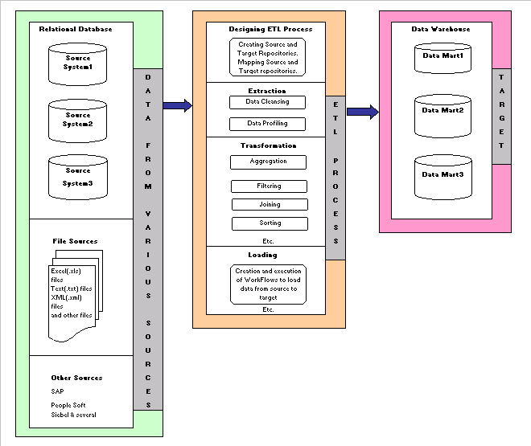
ETL Process

Slide 4
ETL Process

Slide 5
ETL Process

Slide 6
ETL Process

Slide 7
ETL Process

Slide 8
ETL Process

Slide 9
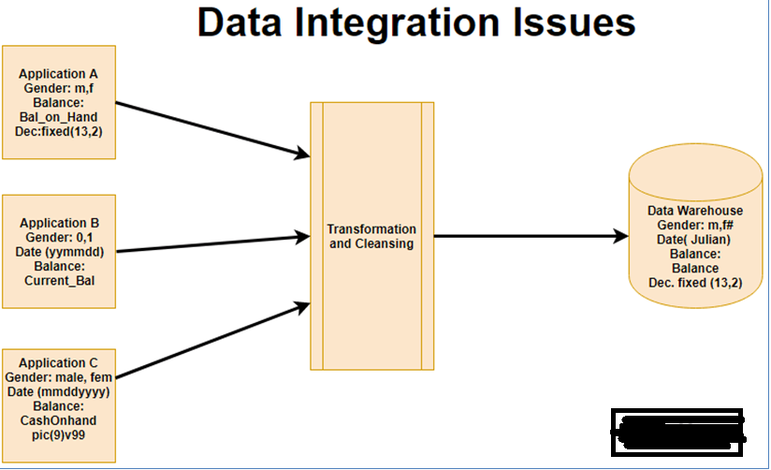

Slide 14
Naming Terminology, Data types, Date Formats are finally ONE

Slide 15
Designing ETL Process

Slide 16
Source & Destination
Creating Sources & Destinations
OLE DB
Flat File
Excel
XML
Mapping Sources & Destinations
Through Transformation Layer
Derived Column
Conditional Split
Aggregation

Slide 17
Extraction

Slide 18
Data Cleansing
It is the process of amending or removing data in a database that is incorrect, incomplete, improperly formatted, or duplicated.

Slide 19
Data Profiling
By data profiling you can:
To know maximum, minimum, standard deviation of values from a numeric column
To know number of nulls in a column
To know count of records for each distinct value from a column

Slide 20
Transformation

Slide 21
Aggregation
To calculate sum, max, min, avg, count from the data source for different columns and transfer summarized values to destination.

Slide 22
Filtering
It is like the “where” clause of SQL statement.
From Data Source as per the requirement transferring conditional records to the destination.

Slide 23
Joining
Combining data from multiple sources and transferring into a destination.

Slide 24
Sorting
Rearranging rows from the source (ascending or descending ) as sending to the destination.

Slide 25
Loading

Slide 26
Work Flow
Tasks are elements that define units of work that are performed in a package flow.
An ETL tool is made up of one or more tasks.
If the package contains more than one task, they are connected and sequenced in the control flow by precedence constraints.

Slide 27
Some examples of ETL

Slide 28
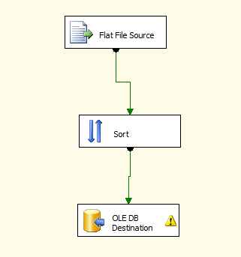
E.g. 1 Transformation from text files to Databases

Slide 29
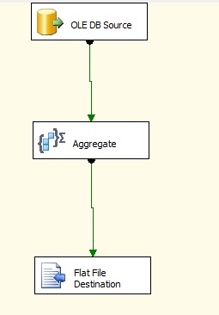
E.g. 2 Transformation from databases to text files

Slide 30
ETL Tools
Tool Name | Company Name
Ab Initio | Ab Initio Software Corporation
Data Stage | IBM
Informatica Power Centre | Informatica Corporation
SQL Server Integration Services (SSIS) | Microsoft
Oracle Warehouse Builder | Oracle Corporation
Data Integration Studio | SAS
Teradata Decision Expert | Teradata
Data Integrator | SAP BO
And there are many more……….

